Slide 1


Slide 2
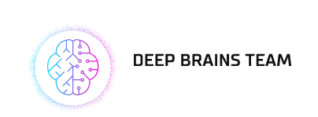


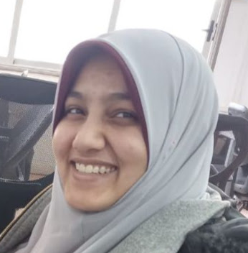
Theme 1
Al-Shimaa Gamal
Abdelmageed Ahmed
Aalaa Nagy
OUR TEAM is made up of highly skilled and passionate individuals with backgrounds in machine learning, data science, and software engineering.

Slide 3
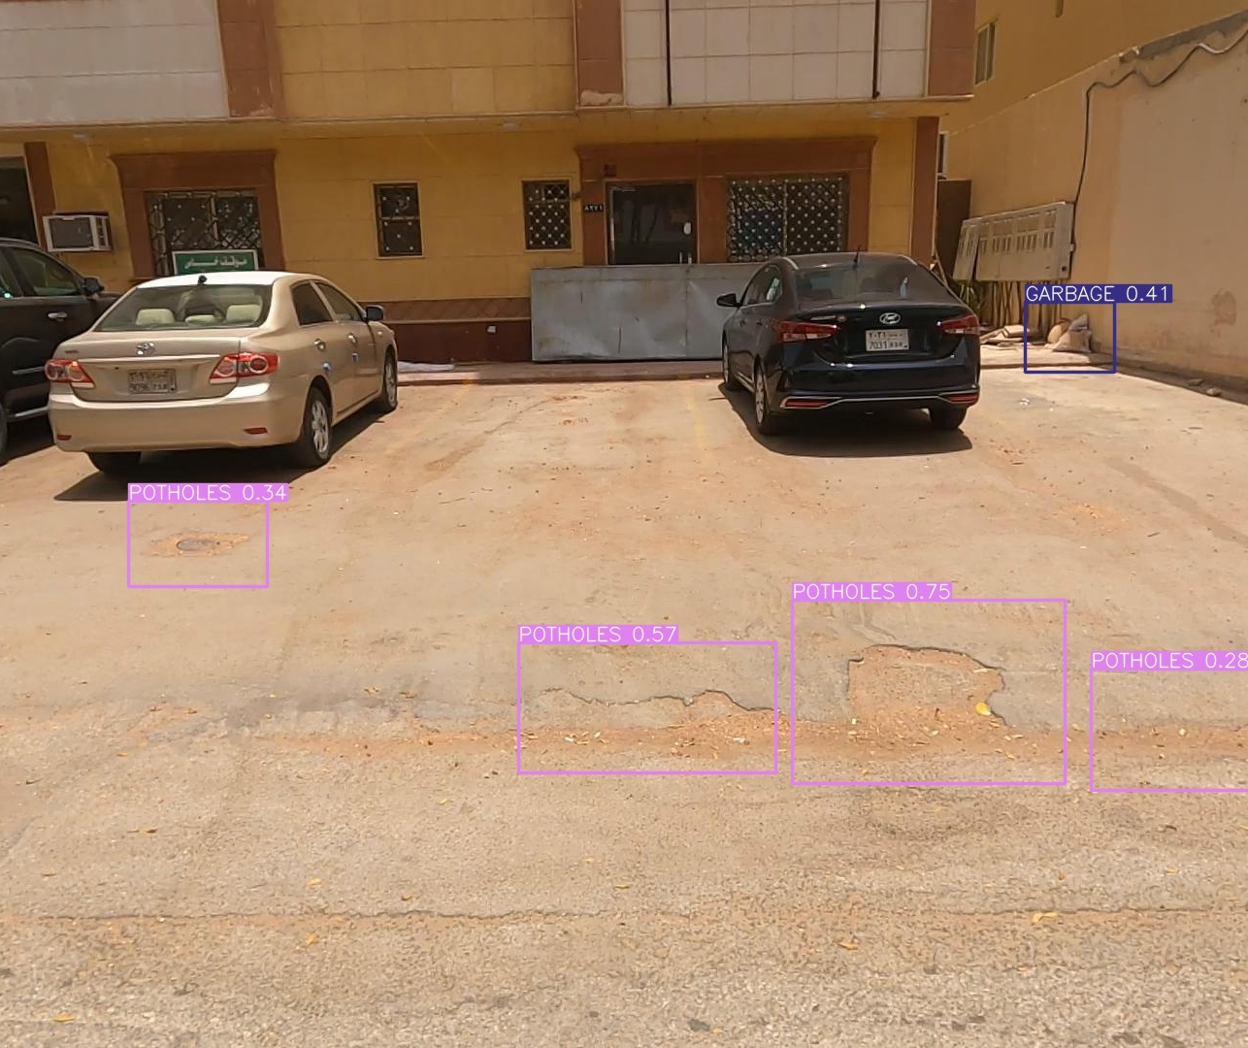
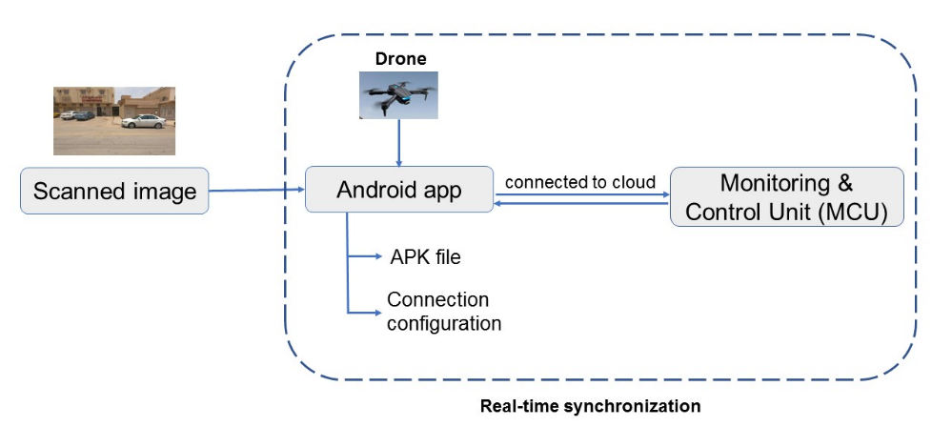
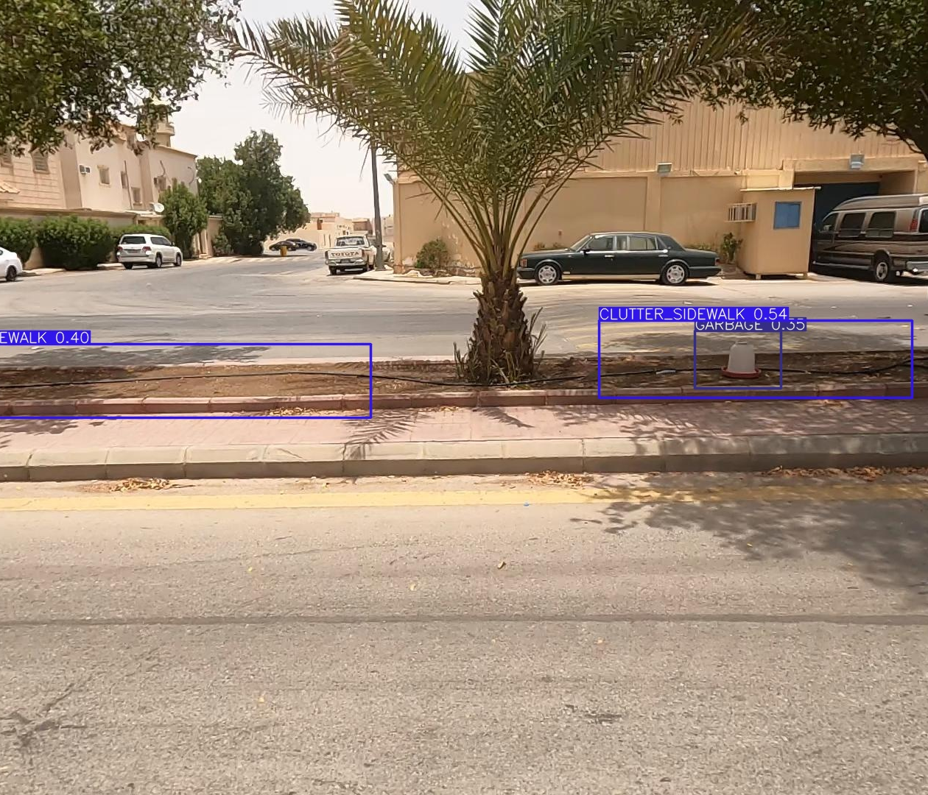
Project Overview
SEE is an AI-powered object detection system that detects and classifies visual pollutants in real-time, using state-of-the-art computer vision techniques. It can be installed on various devices and connected to GPS and the internet to send real-time notifications of detected pollutants to city officials and display them on a monitoring dashboard for immediate action.

Slide 4
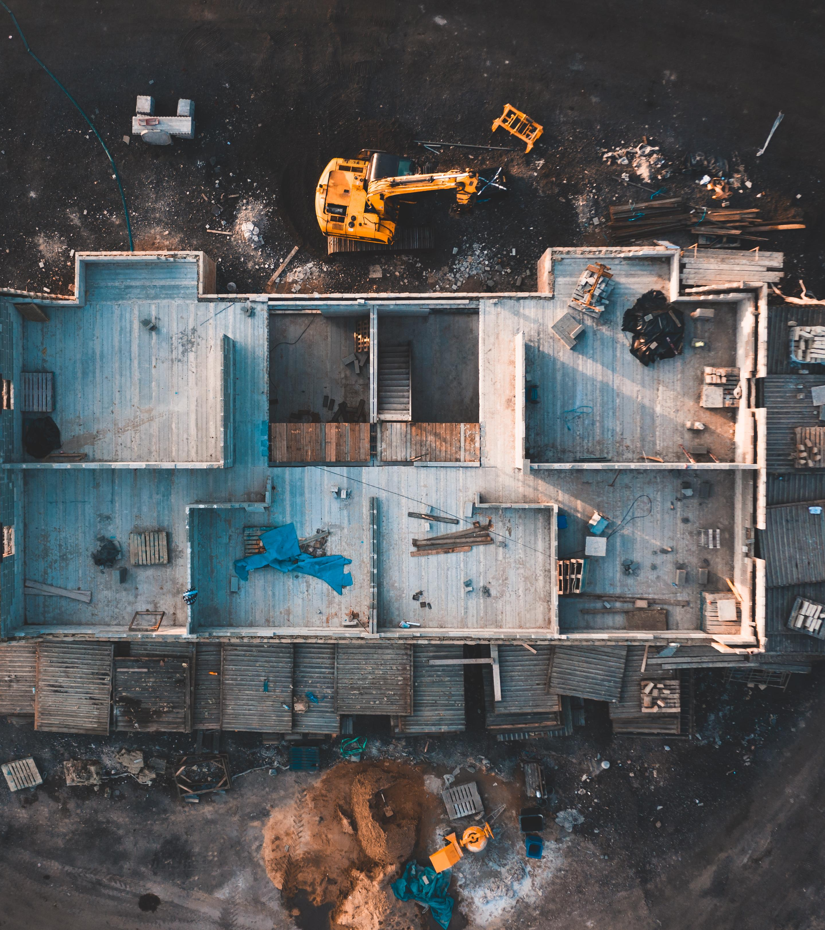
Challenges
Built a model that can generalize well regardless:
some human error in annotations
partially annotated images
inaccurate bounding boxes

Slide 5
Solution Approaches
01
02
Original data Preprocessing
Manually data correction
Covert pascal VOC to Yolo
Train over Yolov7
Model Hyperparameters tuning
Get model that can generalize
Correct the incorrect labels, annotate the unannotated objects
Adjust the boxes of some object that doesn’t match/cover the whole object
Train over Yolov7
Get robust model

Slide 6
(Automation of Data Annotation)
How to scale solution over large size of Data? Scaling The Project Over Millions of Collected Images is very difficult task to be achieved with traditional data annotation method , We can use AI to help in data annotation
CLIP Segmentation Transformer
Yolo with Human in The Loop

Slide 7
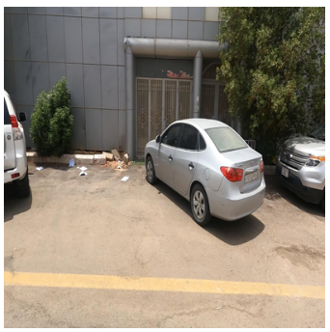
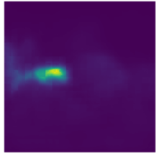
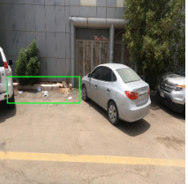
1. CLIP Segmentation Transformer
CLIPSeg is a transformer-based model learns to associate the textual information in the captions with the visual information in the images, allowing it to make predictions about the location and identity of objects within new images.
It takes a text prompt and an images and produces the heatmap showing the region that associate to the text description
Example on Garbage text prompt :
Prompt = [‘garbage’]
Model results
Plotting bounding box

Slide 8
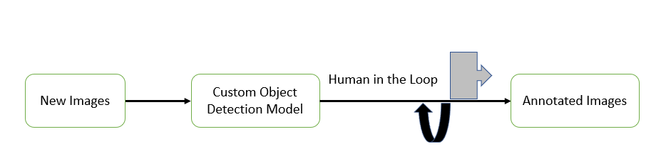
2. Yolo with Human in The Loop
Use a pre-trained custom model trained on a few thousands of manually annotated data that achieved a high mAP on testing data to help in annotation , Using the prediction of the model as an annotation, and human to correct the wrong prediction

Slide 9
Solution scaling over detection (Edge-based deployment)

Slide 10
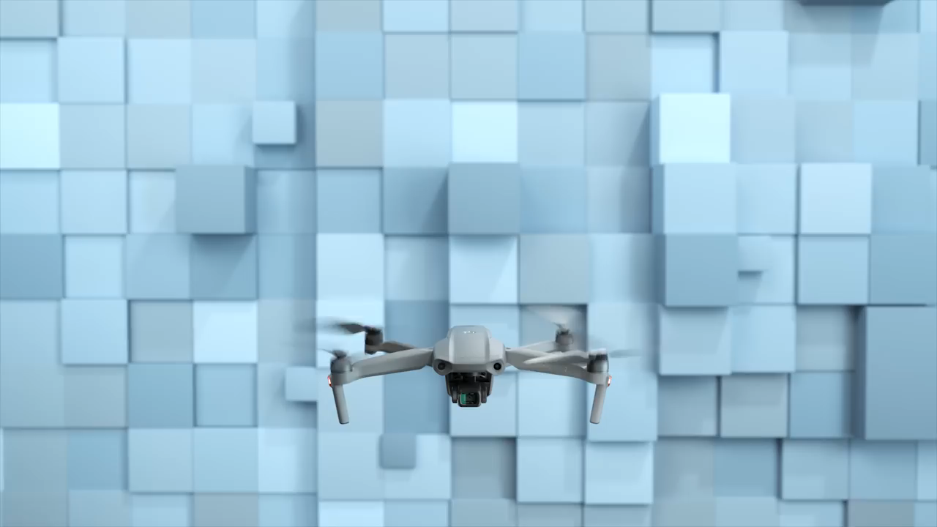
Edge-based deployment
Running the model on edge devices like cameras (drone),smart phones
Deploying multiple models simultaneously on different edge devices.
Reduced Bandwidth
Cost-effective
Increased Privacy and Security
Mavic Air 2 costs: USD $799

Slide 11






Used Opensource Tools

Slide 12
Future Work
We just built the prototype of the AI model and a simple app from it ; In case we have more resource like drone / camera support android we can run the apk file on a drone / camera and build a custom dashboard to monitor and visualize the detected results.
with more data we can use the prototype model to annotate large amount of data with the human in the loop to correct the wrong annotation and build a more robust model.
The system can also be used to track and analyze the effectiveness of cleanup efforts over time, by providing detailed reports and statistics. With more resources and data, the system could potentially be expanded to detect and classify other forms of pollution, such as air and water pollution, making it a comprehensive solution to keep the environment clean and safe.

Slide 13
Thanks

